Slide 1
Consumers models and roles
Lesson-3

Slide 2
Consumers Models:
Gordon and Valentine highlighted seven models of thinking about the consumer from the Second World War to the twenty-first century:
The marginalized consumer. This approach held sway in the seller’s market in the postwar years, where sellers produced goods and services without consulting consumers.
The statistical consumer. This approach was dominant during the buyer’s market of the 1950s, where positivist research methods were used to determine what consumers wanted. However, the consumer was profiled objectively in averages and facts—the ‘what’ and ‘how many’.
The secretive consumer. This approach evolved in the 1960s, when researchers focused on the ‘why’ of consumers’ hidden motivations. This era (1970-1980) of motivational research led to interpretivist research techniques borrowed from psychology and psychoanalysis. Researchers included research approaches such as brain science, cultural analysis, ethnography and semiotics.
The sophisticated consumer. Under this approach, the consumer was seen to be consuming advertising and experiences as well as goods and services. Marketers consulted sophisticated and aware consumers on marketing activities.

Slide 3
Consumers Models:
5- The satellite consumer. During the 1970s and 1980s, marketers developed a brand-centric model to pull consumers to brands—brand repertoire, brand positioning, brand equity and brand personality. The brand was considered a planet while the consumer was regarded as a moon drawn towards the planet.
6- The multi-headed consumer. This model of thinking considered the different ‘need states’ of the consumer, depending on the context of the environment, the situation, external factors and emotional needs. The consumer has repertoire behavior or multi-wants; for example, ordering a beer in a pub one day and wine in the same pub another day, depending on the social company, the occasion, the weather and the atmosphere.
7- The mutable consumer. The twenty-first-century consumer is described as a thinking person who dynamically constructs multiple identities continually over time and space. Hence, a consumer could play the role of a cook or Santa Claus in different situations; or be a family member, ‘couch potato’ and internet surfer on other occasions. These are ever-changing ‘moments of identity’.

Slide 4
https://youtu.be/OLSsswr6z9Y Got milk ad
GOT MILK?
Milk consumption in California had declined for 15 years from the 1970s to early 1990s, even with advertising that ‘Milk does a body good’. Consumers were aware of the benefits of daily milk consumption, including nutrition, health and calcium.
However, youths considered milk to be boring and dull when compared with the active lifestyle projected by brands of beverages and soft drinks. Unlike the bulky milk packaging, competitive beverages were more conveniently and innovatively packaged in different forms, shapes, sizes and colors. Hence, youths were consuming soft drinks in different situations and places.
Creative advertising also helped competitive beverages. Mountain Dew’s ‘Do the Dew’ campaign projected the brand as more potent than ultra-dangerous feats. Gatorade featured basketball celebrity Michael Jordan, with the tag ‘Be like Mike’. Sprite appealed to playful cynicism, using rap artists to convey hip-hop culture in its ‘Obey your thirst’ campaign.
The California Milk Processor Board (CMPB) took action in 1993. The largest milk producers contributed three cents per gallon to fund the yearly advertising budget of US$23 million. CMPB targeted the existing 70 per cent of Californians who were frequent milk consumers to get them to drink more milk at home.
Working on an initial strategy that milk complements brownies, cookies or sandwiches, research showed that consumers were upset if there was no milk at home. Thus emerged an emotional deprivation advertising appeal. The expression of this milk-deprived moment became ‘Got milk?’.
The first television commercial featured a history buff whose correct answer to a radio contest question was unintelligible to the DJ—all because the history buff had no milk to wash down the peanut butter sandwich in his mouth. The commercial won the advertising ‘Oscar’ at the 1994 Clio Awards.
Milk sales increased by 15 million gallons in 1994. A second television commercial featured an obnoxious yuppie in Hell, where milk cartons were empty. Milk was then seen as ‘cool’. Another entertaining commercial later depicted a fictional ‘Town without milk’. ‘Got milk?’ messages also appeared on billboards, bus stops, shopping floors and stickers on bananas (which were popular with cereals).

Slide 5
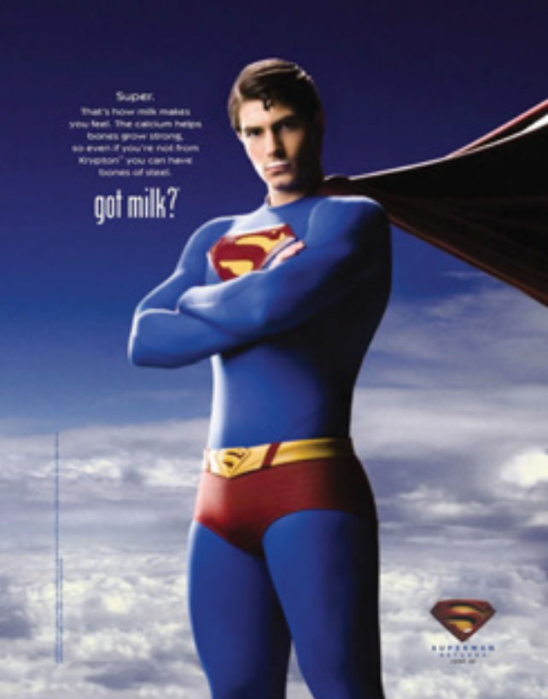
Jeff Manning, who was the then Executive Director of CMPB, shared his lessons from the successful ‘Got milk?’ campaign:
Seek strategic partners. ‘Got milk’ appeared on Nestlé Nesquik box tops, Nabisco cookies and Dole bananas. There was also co-branding with Barbie Doll, Girl Scouts of America and Sesame Street’s Cookie Monster.
Address changing trends. When foods and beverages were calcium-fortified, the ‘Got milk?’ campaign leveraged current events and medical research to reinforce milk’s calcium benefits.
Target ethnic markets wisely. For example, the large Hispanic segment did not think that the milk deprivation situation was funny; in fact ‘Got milk?’ in translation came o_ as ‘Are you lactating?’ Hence, CMPB focused on milk-based recipes and cooking, which appealed culturally to Hispanics.
Leverage strategic publicity. Use the news media proactively to write about new executions of the advertisements. News media also picked up stories on the successful Hispanic strategy.
Create association assets. CMPB licensed the ‘Got milk?’ trademark and campaign in 1997 to dairy organizations around the country. The famous mnemonic milk-moustache campaign emerged from this association

Slide 6
CUSTOMER ORIENTATION : WHO IS THE REAL CUSTOMER ?
The customer is at the core of the market orientation concept. Any marketplace transaction requires at least three customer roles : (1) buying, that is selecting a product or service ; (2) paying for it, and (3) using or consuming it. Thus, a customer can be a buyer, a payer, or a user/consumer. Each of these roles may be carried out by the same person (for example the housewife) or an organizational unit (for example the purchase department) or by different persons or departments. The person who pays for the product or service is not always the one who is going to use it. Nor is the person who uses it always the person who purchases it. Any of the three customer roles (user, payer, or buyer) makes a person a customer. It is also clear that the values sought by each customer role can be different : the service value for the buyer, the price value for the payer and the performance value for the user/consumer.

Slide 7
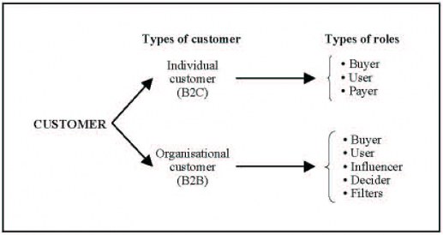
The different customer roles

Slide 8
Customer roles specialization
In any market, it is important, to know the possible ways in which customers divide their three roles (buyer, payer, user) among themselves in order to adapt the marketing efforts to the type of role specialization. Four types of role specialization can be identified.
User is buyer and payer. Most consumer products purchased for personal use fall into this category, like clothing, watches, sporting goods, haircuts, and so on. A single person combines all three roles. This is the traditional domain of consumer analysis, even if the same concentration of roles can also be observed in business markets for small business owners.
User is neither payer nor buyer. Here the user is different from both the payer and the buyer, a situation met in consumer markets for a whole range of products purchased by the housewife for her household or children’s use.
User is buyer but is not payer. In some situations, the user may be the buyer but is not the payer for the product or service. All purchasing decisions made on expense accounts fall into this category. Also the user, who is nevertheless the buyer, does not pay the services offered within the framework of insurance coverage or social security programs. The risk of over-consumption is often observed in this type of situations.
User is payer but not buyer. In some cases, the user is payer but is not the buyer. For example, in the financial markets, stockbrokers act as agents for clients.

Slide 9
When a single customer embodies all the roles, the firm will use a different strategy than when different people are user, payer, and buyer. Mastering this set of information about buying habits will contribute to a significant improvement in the firm’s marketing practice and thus increase the impact of the behavioral response.

